Slide 1


SKY GYM MANAGEMENT SYSTEM

Slide 2



Our Client
Sky Gym ,the biggest and most modernized Gym in Kandy.
Established in 2015.
1643 registered Members.
18 professional trainers.
Requires an online store

Slide 3


PROBLEMS & SOLUTIONS
Customer Management and Employee Management
Handling Customers & Trainers
Marketing the Gym – posters etc.
Attractive and Informative Webpages
Diet Plan Management
Diet Plans

Slide 4
PROBLEMS & SOLUTIONS Cont’d.
Workout schedules for customers
Schedule Management
Inventory control and management
Inventory Management System
Bill payments – no proper records
Payment Management

Slide 5
Benefits of the System
Efficiency
Records will be reliable and accurate.
Better management and control.

Slide 6
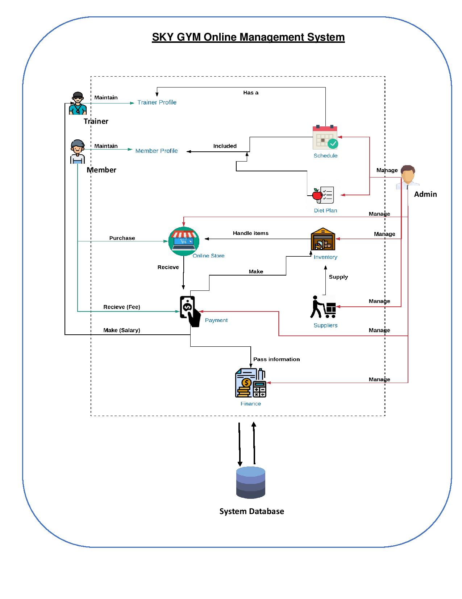

System Overview

Slide 7
FUNCTIONALITIES
Customer
Employee
Schedule
Payment
Diet
Customer
Finance
Inventory
Report

Slide 8
Customer Management
Profile Creation
Mark Attendance
Generate Customer Reports
Update his/her Personal Information
Search Member

Slide 9
Employee Management
Add/Update/Delete Employees
Mark Attendance
Calculate Salary
Search Employee(s)
Generate Reports

Slide 10
Schedule Management
Add/Update/Delete Schedules
Suggest Schedules According to Gender and
Category
Generate Overall & Gender based Reports
Assign Schedules to Trainers
Search Schedules

Slide 11
Payment Management
Add/Update/ Delete Payment Schemes
Process Payments - Membership and Bill payments
Notify Dues
Make Payments - Bill payments and Salary Payments
Search payment history and using Receipt No.
Create overall reports.

Slide 12
Diet Plan Management
Add/Delete/Update Diet Plans
Suggest Diet Plans based on BMI
Search Diet Plan
Generate Overall Reports

Slide 13
Online Store
Add/Update/Delete Product of the Store
Handle Store Customer Payments
Shopping Cart
Search Item in Store
Generate Customer Purchase Reports

Slide 14
Finance Management
Add/Update/Delete Income & Expenditure
Calculate Net Profit
Generate Monthly/ Annual Reports
Search for an Income or Expenditure

Slide 15
Inventory Management
Add/Update/Delete Inventory
Search Item in Inventory
Request for Maintenance

Slide 16
Report Management
Update/Delete Reports
Organize Reports
Search Reports

Slide 17



TOOL & TECHNOLOGIES

Slide 18
Functionality Distribution
Name with Initials | Brief Description of the Function
Z.M.M. Akaam | Inventory Management (Gym) Report Management
Sangeeth Raj .A | Online Store
Krishnamoorthy.N | Schedule Management
Edirisinghe E.N.V | Employee Management
Jayasooriya D.C. | Diet Plan Management
J.L Thilini Randika | Customer Management
Devduni.R.M.B | Payment Management
Imalsha Kavindi K.G. | Finance Management

Slide 19
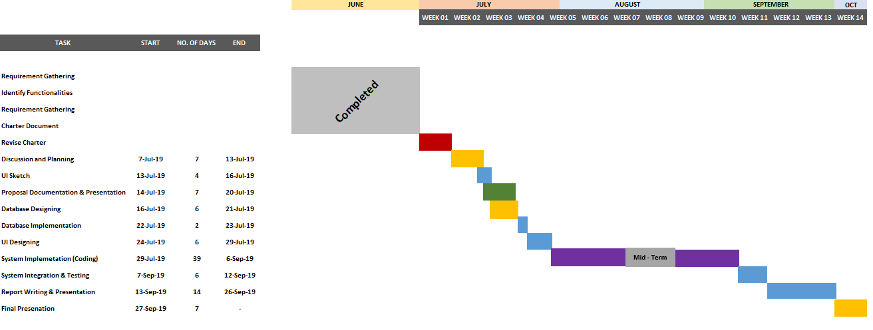
Gantt Chart

Slide 20
Thank You

